Slide 1


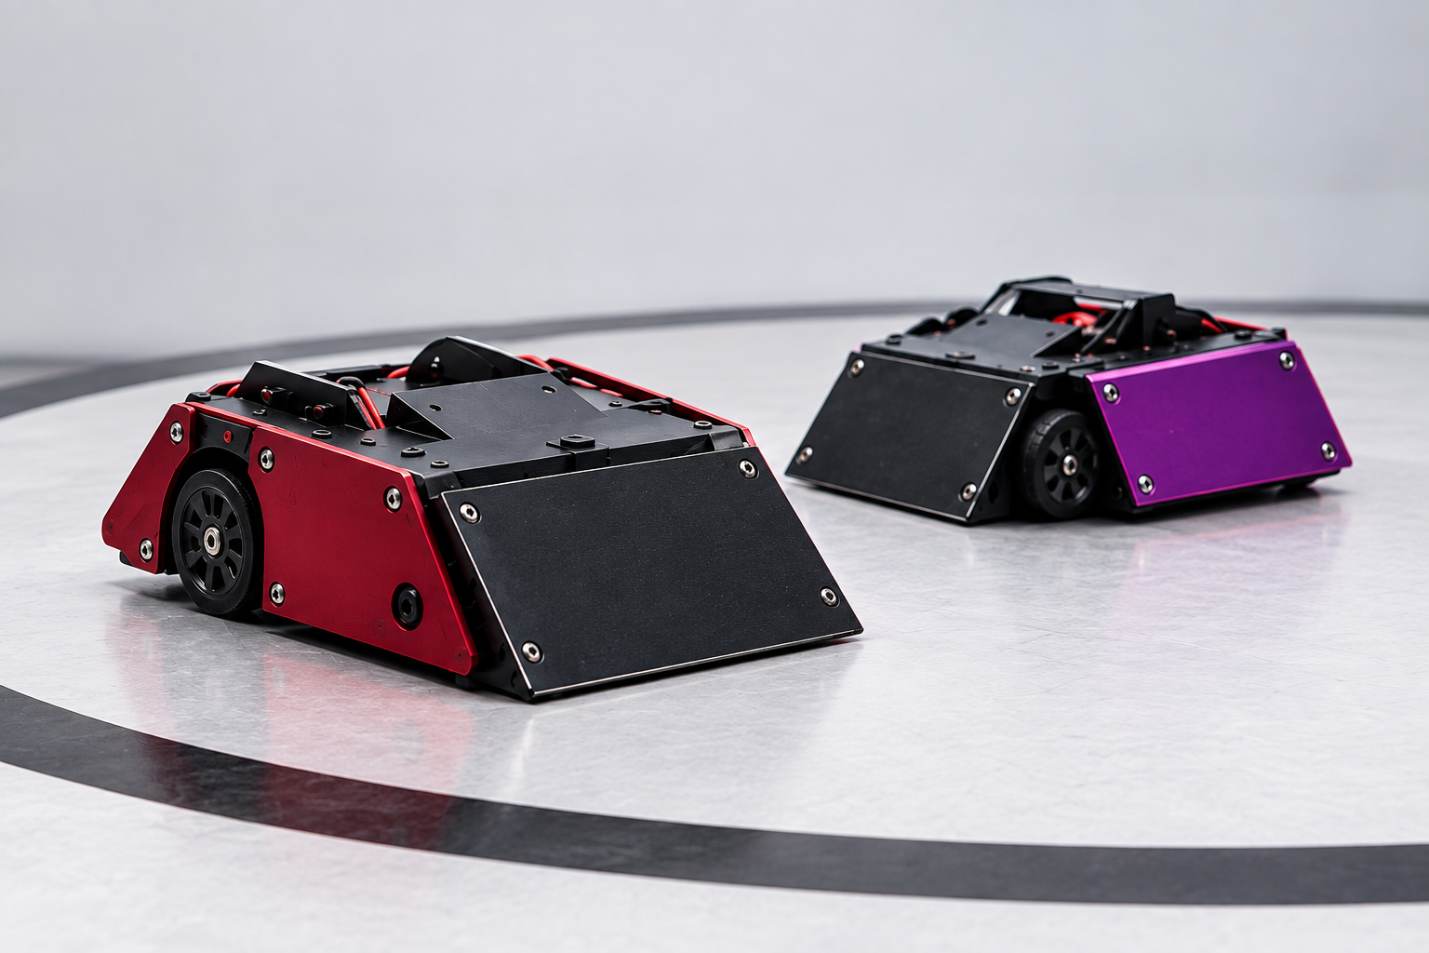
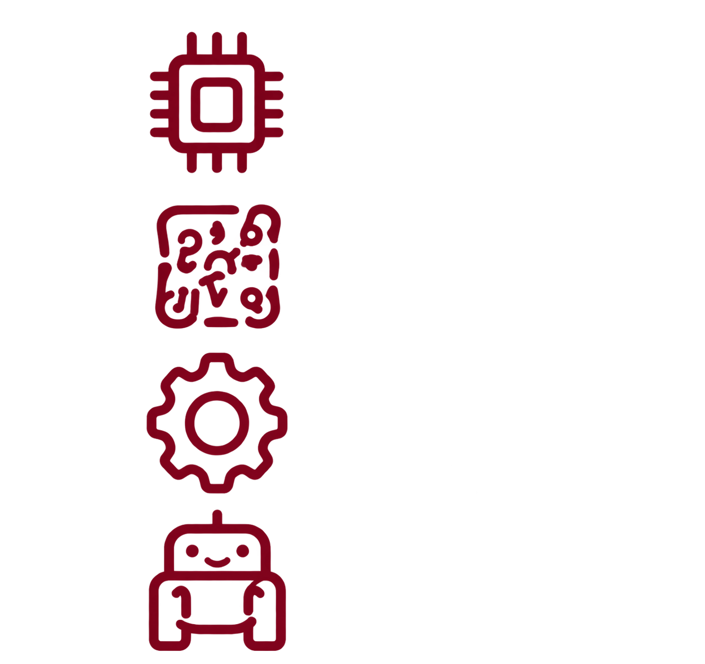


Robotics Workshop
From Electronics to
Sumo Robot
Microcontrollers
Electronics
Sensors & Motors
Sumo Robot Competition
SESSION 2

Slide 2
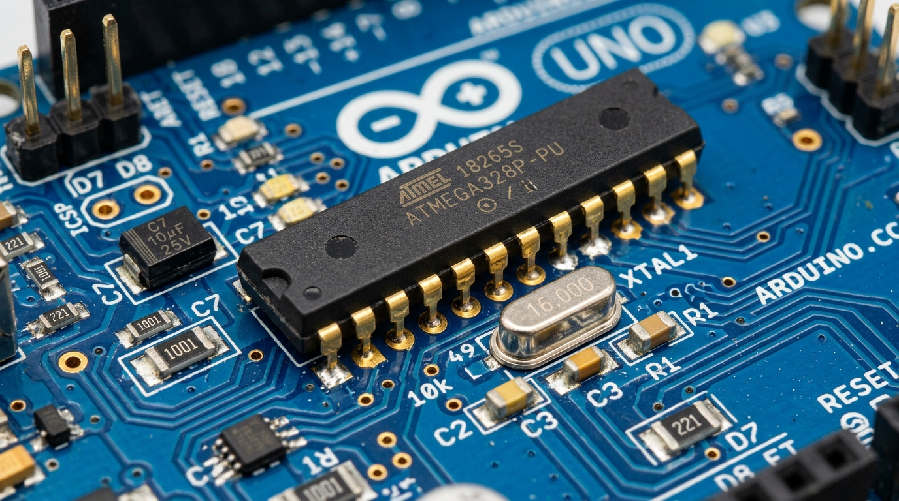
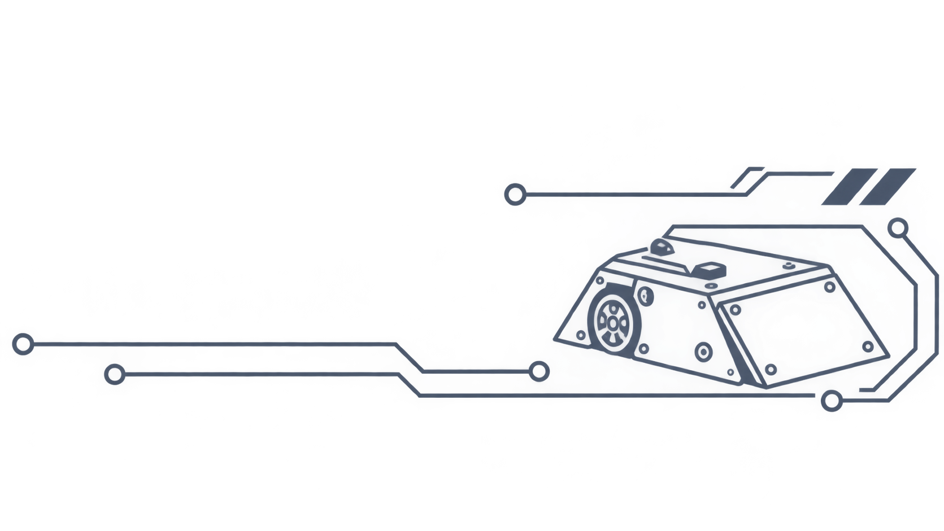

01
Hands-On Robotics Workshop
Why Connecting Motors to Microcontroller Pins Destroys the Board
• Arduino Pin Limit (40mA Max)
• DC Motor Appetite (~150mA): Standard yellow gearmotors draw 150mA running free
• Continuous Brownout Resets: Huge current spikes collapse, forcing the microcontroller into continuous reboot loops.
SESSION 2

Slide 3
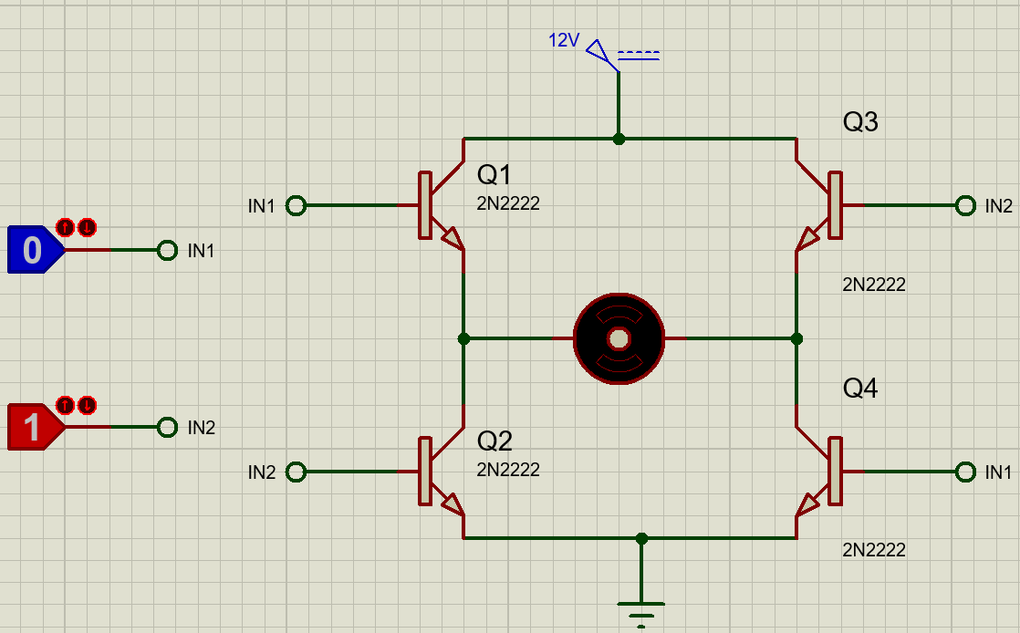
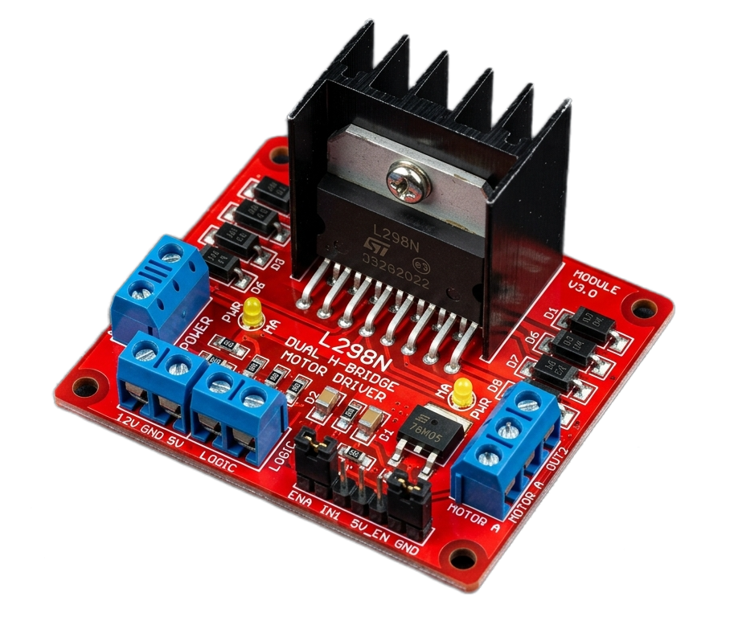
02
Hands-On Robotics Workshop
H-Bridge: Direction Control | Polarity Reversal Using 4 Solid-State Switches
• Why H-Bridge: DC motors rotate clockwise or counter-clockwise depending on voltage polarity.
• 4-Switch Topology: Four transistor switches (S1–S4) arranged in an 'H' bridge route high-current battery flow.
• Forward Conduction (S1 + S4): Current flows from Battery (+) through S1, across the motor left-to-right, through S4 to GND. Wheels spin forward.
• Reverse Conduction (S2 + S3): Current flows from Battery (+) through S3, across the motor right-to-left, through S2 to GND. Wheels spin in reverse.
• Monolithic Dual Driver: L298N integrates two complete full-bridge drivers on a single silicon die, controlling two DC motors independently.
SESSION 2

Slide 4

03
Hands-On Robotics Workshop
Pulse Width Modulation for Speed
• Why PWM Matters
Microcontrollers cannot output analog voltages. Instead, they switch 5V ON and OFF rapidly.
• Software Control: analogWrite()
Takes an 8-bit integer from 0 (0% duty, stopped) to 255 (100% duty, maximum battery voltage and full speed).
• Combat Traction Modulation: Full speed (255) on initial launch causes wheel slip on smooth MDF Dohyo. Ramping PWM from 150 to 255 ensures ring-gripping push.
Let’s see this on oscilloscope
SESSION 2

Slide 5
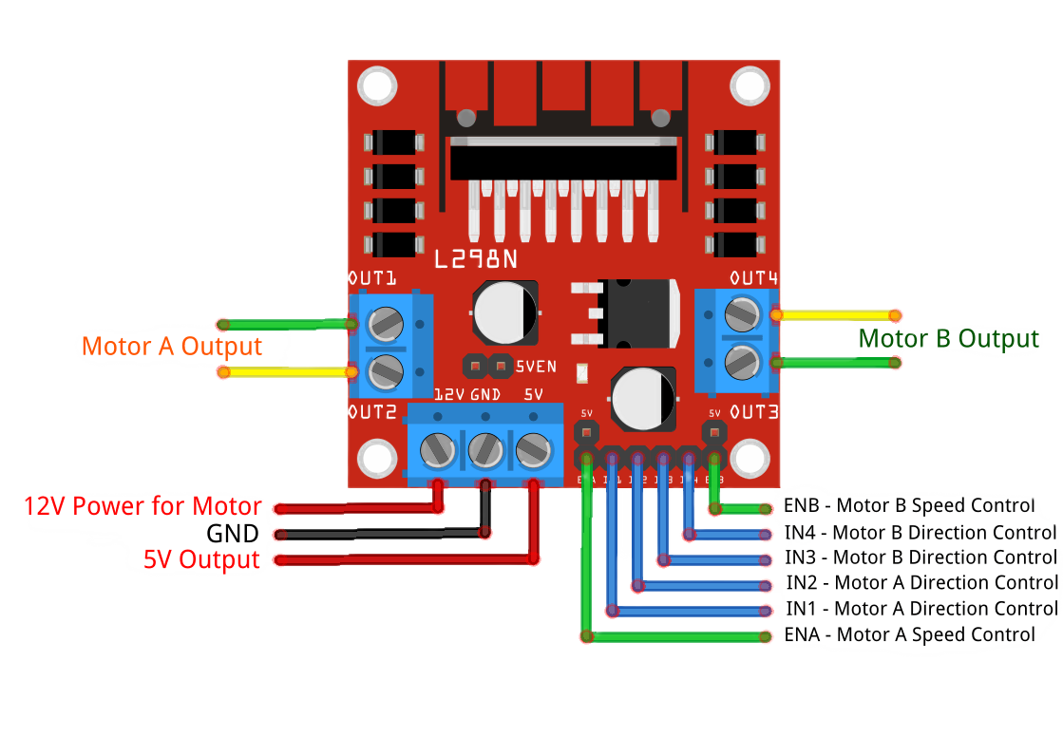
04
Hands-On Robotics Workshop
L298N Pinout
• Power Screw Terminals: VCC (12V Battery (+)), GND (Shared Common 0V reference with Arduino GND), +5V (Supply terminal).
• Motor Output Terminals: OUT1 & OUT2 connect to Left Motor A; OUT3 & OUT4 connect to Right Motor B. Swapping wires inverts default spin direction.
• Direction Logic Headers: IN1 & IN2 govern Left Motor A direction; IN3 & IN4 govern Right Motor B direction. Connect directly to Arduino digital GPIO.
SESSION 2

Slide 6

05
Hands-On Robotics Workshop
Exercise_1: Control a motor
1- Open simulation software (Proteus ) do the wiring
2- Open IDE and write the code
3- Burn the code on the microcontroller
SESSION 2

Slide 7
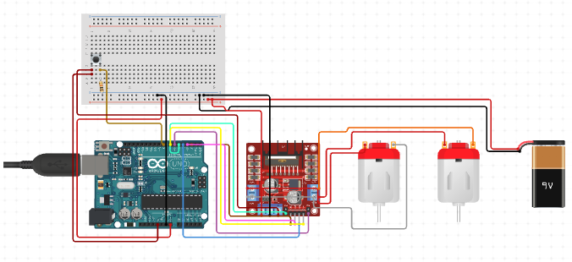
06
Hands-On Robotics Workshop
SESSION 2

Slide 8
07
Hands-On Robotics Workshop
Movement Functions Forward & Reverse
• digitalWrite(pin, HIGH/LOW): Controls motor rotation! HIGH connects wire to 5V; LOW connects to 0V. Left Motor Forward: IN1=HIGH, IN2=LOW. Right Motor: IN3=HIGH, IN4=LOW.
• Inverting for Reverse: To back up, we swap the voltages! Left Motor Reverse: IN1=LOW, IN2=HIGH. Right Motor Reverse: IN3=LOW, IN4=HIGH.
• analog Write(pin, SPEED): Controls how fast wheels turn using PWM (0 = stopped, 255 = full power). Setting SPEED = 200 provides high pushing torque without tipping.
SESSION 2

Slide 9
08
Hands-On Robotics Workshop
Turning & Stopping Spins & Dynamic Brake
• Tank Spin (Zero-Radius Turn): To spin left on the spot, wheels turn in opposite directions: Left wheel goes Reverse (IN1=0, IN2=1), Right wheel goes Forward (IN3=1, IN4=0).
• Spin Maneuver: Left wheel Forward (IN1=1, IN2=0), Right wheel Reverse (IN3=0, IN4=1). The robot pirouettes around its center vertical axis!
• Spin drifting: instead of switching gates , you simply change the PWM speed !
• What is Dynamic Braking?: stopMotors() sets all direction pins to LOW (IN1=0, IN2=0, IN3=0, IN4=0). This shorts the motor coils directly across ground!
SESSION 2

Slide 10
09
Hands-On Robotics Workshop
LAB_1
Control 2 Motors, write the following functions
moveForward();
moveBackward();
turnRight();
turnLeft();
Stop();
Try on simulation first, then hardware
SESSION 2

Slide 11
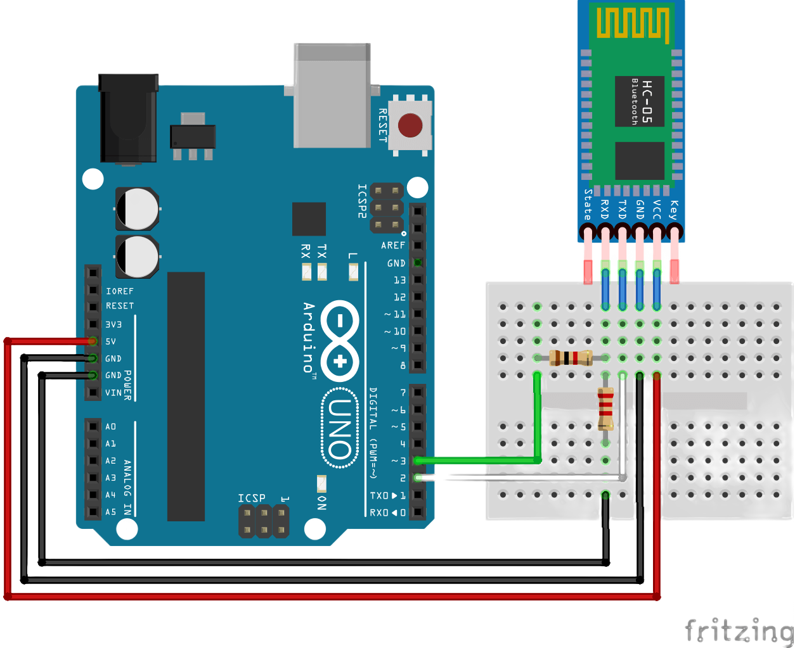
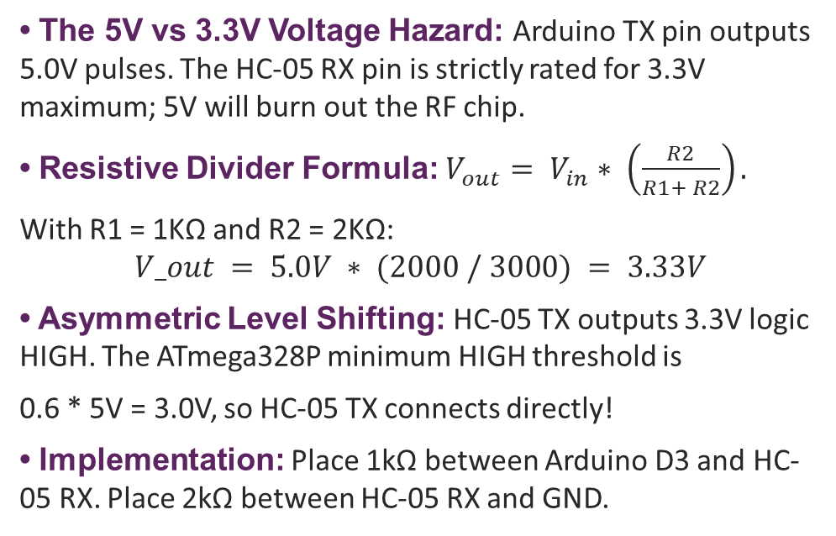
10
Hands-On Robotics Workshop
3.3V RX Protection: Voltage Divider
• The 5V vs 3.3V Voltage Hazard: Arduino TX pin outputs 5.0V pulses. The HC-05 RX pin is strictly rated for 3.3V maximum; 5V will burn out the RF chip.
• Resistive Divider Formula: $V_{out}= V_{in}∗ \left(\frac{R2}{R1+ R2}\right).$
With R1 = 1KΩ and R2 = 2KΩ:
$$V_out = 5.0V ∗ (2000 / 3000) = 3.33V$$
• Asymmetric Level Shifting: HC-05 TX outputs 3.3V logic HIGH. The ATmega328P minimum HIGH threshold is
0.6 * 5V = 3.0V, so HC-05 TX connects directly!
• Implementation: Place 1kΩ between Arduino D3 and HC-05 RX. Place 2kΩ between HC-05 RX and GND.
SESSION 2

Slide 12
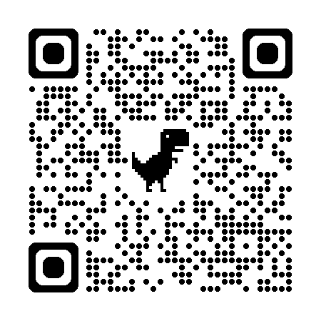
11
Hands-On Robotics Workshop
Dabble App Mobile Bluetooth Gamepad
• In-App Bluetooth Pairing: Open Dabble -> tap the Connect icon -> select HC-05. LED transitions to double-blink.
• Gamepad Module Capabilities: Provides both Digital D-Pad (Up, Down, Left, Right) and an Analog 360° Joystick.
SESSION 2

Slide 13
12
Hands-On Robotics Workshop
Naming Pins & Importing Dabble
• What is #include?: Think of #include <Dabble.h> as opening a toolbox. It gives Arduino new powers (Bluetooth joystick communication) without us writing thousands of lines.
• What is const int?: const int ENA = 5; creates a permanent nickname for Pin 5. Instead of memorizing confusing numbers, we use clear labels like ENA, IN1, and BUTTON_PIN.
• Why Pins 10 & 11?: Digital Pins 0 and 1 are reserved for the USB cable. We use Pins 10 and 11 for Bluetooth so we can upload code and debug at the same time without conflicts.
• Variables & Flags: const int SPEED = 200; sets motor power (0 to 255). bool matchStarted = false; is a yes/no switch that keeps the robot locked until the referee starts the match.
SESSION 2

Slide 14
13
Hands-On Robotics Workshop
What Happens the Moment Arduino Powers ON
• What is setup()?: Every Arduino program must have a setup() function. Arduino runs this code ONLY ONCE the exact second it gets battery power to configure hardware.
• pinMode(pin, OUTPUT): Tells Arduino that this pin will TALK it will send electricity out to the L298N motor driver to turn wheels, or power the status LED.
• pinMode(pin, INPUT): Tells Arduino that this pin will LISTEN it will read whether 5V is flowing in from the push button on Pin 8 when pressed.
• Dabble.begin(9600): Wakes up the Bluetooth link at 9600 baud, telling it that Pin 10 receives data from HC-05 and Pin 11 sends data. stop Motors() ensures safety at boot.
SESSION 2

Slide 15
14
Hands-On Robotics Workshop
How the Robot Reads Your Smartphone Commands
• What is loop()?: After setup(), Arduino runs loop() over and over, thousands of times every second! It is the robot's continuous beating brain.
• Dabble.processInput(): Must be called on every loop. It listens to the Bluetooth module, unpacks data from your phone, and checks which button you are touching.
• if / else Decisions: If you press UP (GamePad.isUpPressed()), it calls moveForward(). If DOWN, it calls reverse(). If LEFT or RIGHT, it spins on the spot.
• Analog Stick & Auto-Stop: GamePad.getX() and getY() read stick deflection (-7 to +7). If you lift your thumb (values near 0), else { stopMotors(); } brakes immediately!
SESSION 2

Slide 16
15
Hands-On Robotics Workshop
LAB_2
Control 2 Motors, Using dabble joystick
Try on simulation first, then hardware
SESSION 2

Slide 17


Thank You

